Slide 1
NAVIO 2 드론 제작
2019년 6월 9일
성병문
한세대학교 자율 비행

Slide 2
NAVIO 개요

Slide 3
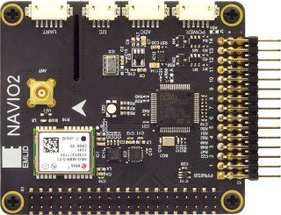
NAVIO2
홈페이지
https://emlid.com/navio/
https://docs.emlid.com/navio2/
What is NAVIO2?
Autopilot HAT(Hardware Attached on Top) for Raspberry Pi
Powered by ArduPilot and ROS
Supports PX4
$ 168
Turn your Raspberry Pi® into a drone controller

Slide 4
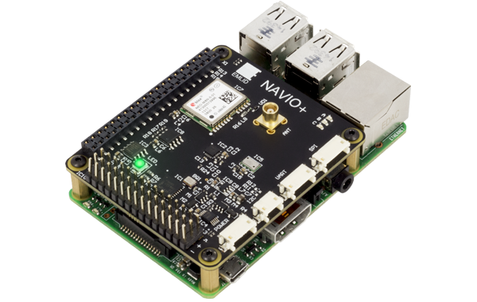
NAVIO2 특징
GNSS receiver
Tracks GPS, GLONASS, Beidou, Galileo and SBAS satellites. External antenna with MCX connector
Dual IMU
Accelerometers, gyroscopes and magnetometers for orientation and motion sensing
RC I/O co-processor
Accepts PPM/SBUS input and provides 14 PWM output channels for motors and servos
High resolution barometer
Senses altitude with 10 cm resolution
Extension ports
Exposed ADC, I2C and UART interfaces for sensors and radios
Triple redundant power supply
With overvoltage protection and power module port for voltage and current sensing

Slide 5

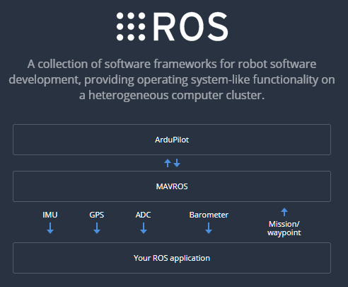
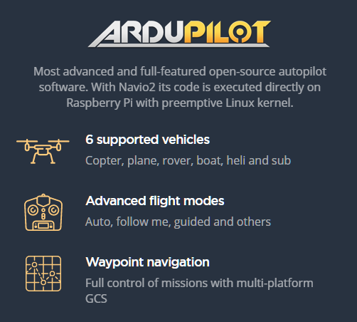
NAVIO OS 설치
This is a Raspbian you know with ArduPilot and ROS preinstalled and ready to run with a couple of simple commands. Also comes with DroneKit and GStreamer

Slide 6
NAVIO H/W 조립
조립

Slide 7
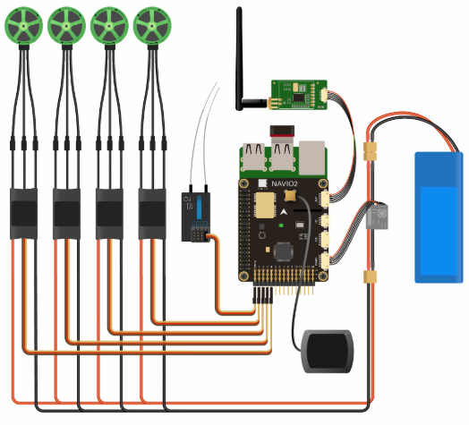
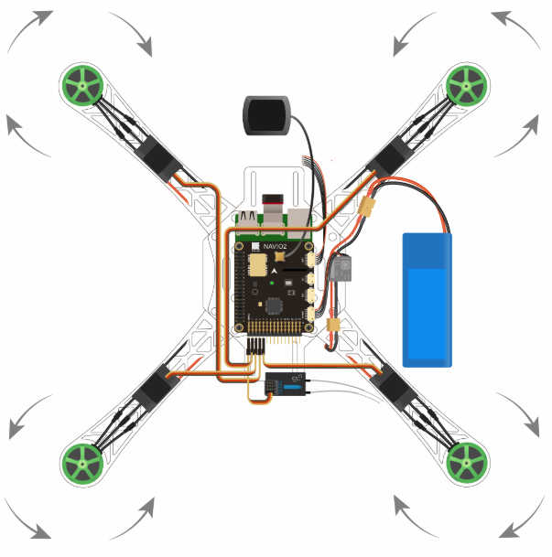
드론 Quadcopter NAVIO 조립

Slide 8
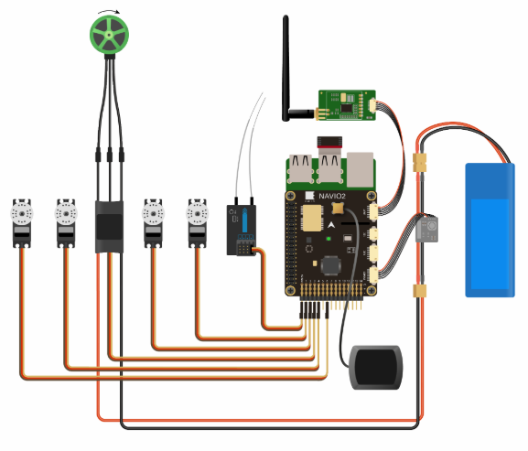
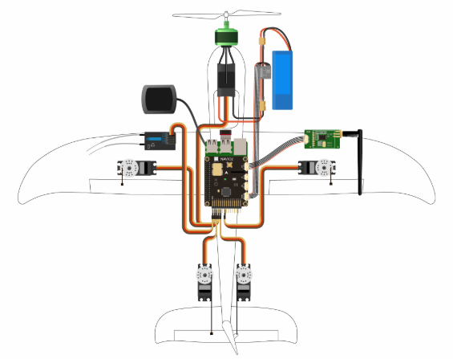
고정익 Plane 조립

Slide 9
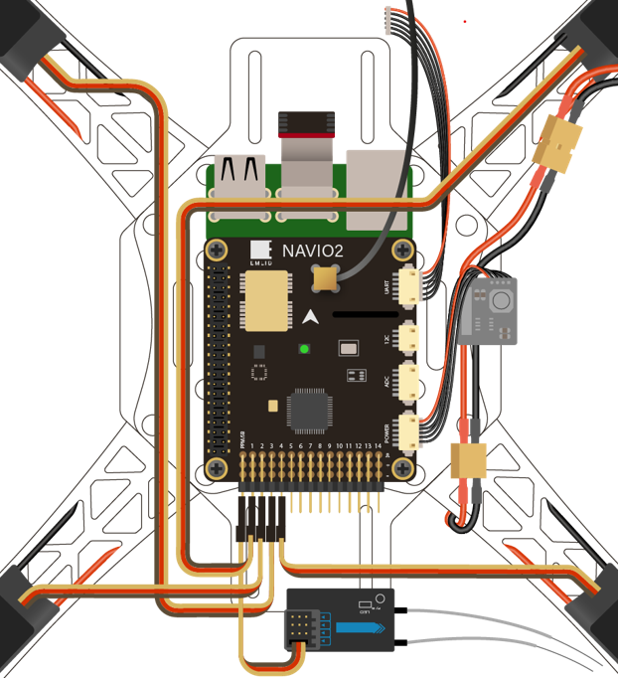

Slide 10
NAVIO2 드론 조립 예
https://community.emlid.com/t/first-build-quadcopter-autonomous-drone-rpi-3-b-navio2/12597
https://www.instructables.com/id/Step-by-step-Guidance-to-Build-a-Drone-From-Scratc/

Slide 11
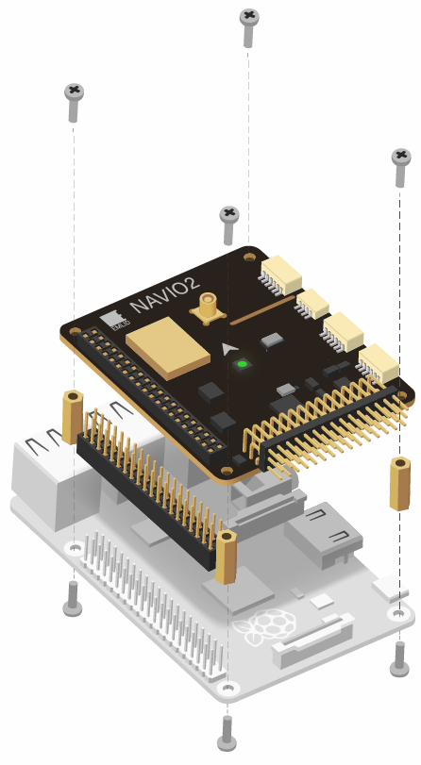
NAVIO2 조립
홈페이지
https://docs.emlid.com/navio2/
Powering Navio2 Attention
ALL POWER SOURCES SHOULD PROVIDE VOLTAGE IN 4.8-5.3V RANGE, OTHERWISE YOU CAN DAMAGE YOUR NAVIO2 AND RASPBERRY PI.**
Navio2 has three power sources, all of them can be used simultaneously as they are protected by ideal diodes.

Slide 12
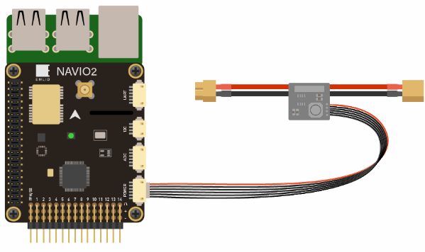
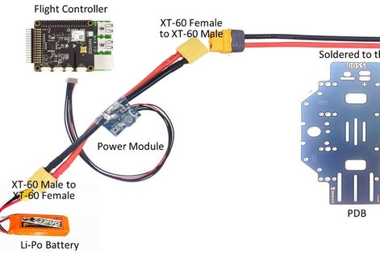
파워 공급 1
Navio2 should be powered by a power module connected to the “POWER” port on Navio2.
Navio2 will provide power to the Raspberry Pi.

Slide 13
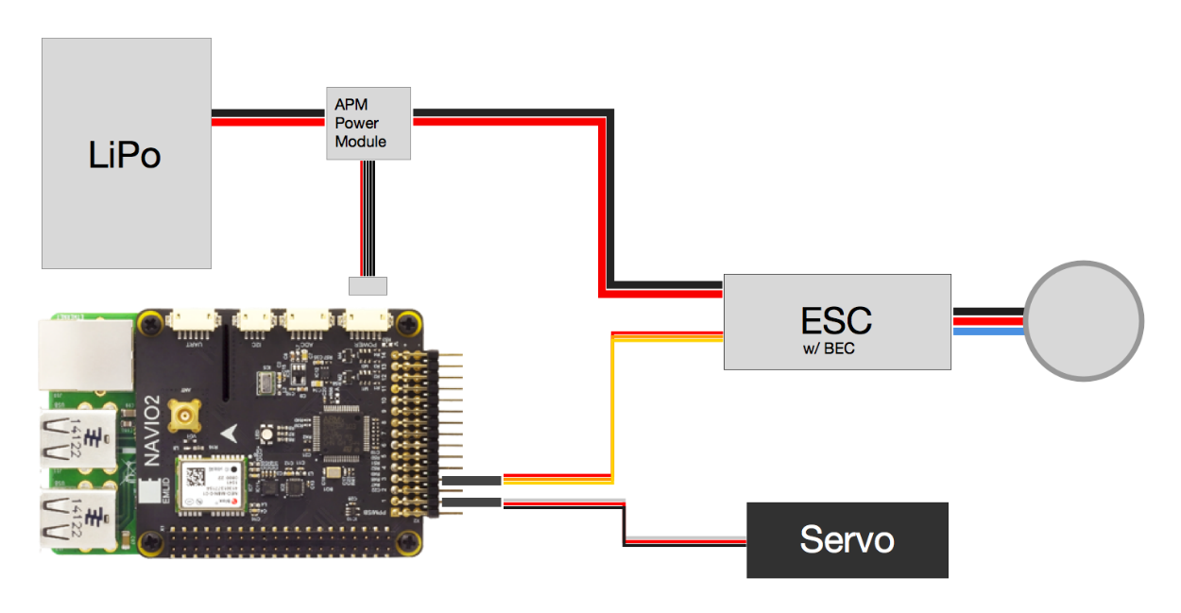
파워 공급

Slide 14
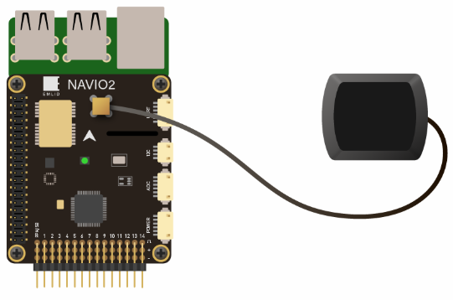
GPS 연결

Slide 15
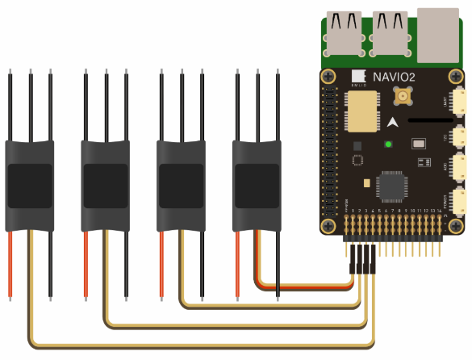
ESC 연결
ESCs are connected to RC outputs labeled from 1 to 14 on a 2.54mm header.
Only one ESC power wire (central) should be connected to Navio2 servo rail, otherwise BECs built in ESCs will heat each other.

Slide 16
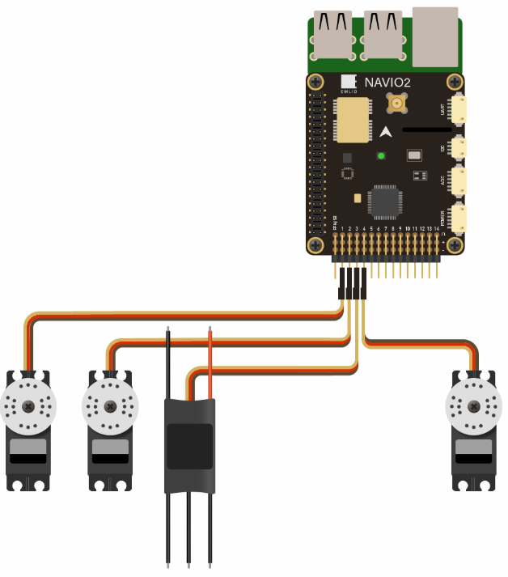
Servo 연결
Servos are connected to RC outputs labeled from 1 to 14 on a 2.54mm header.
Power module does not provide power to servos. To provide power to servos connect BEC to the servo rail. BEC would also serve as back-up power supply to Navio2.

Slide 17
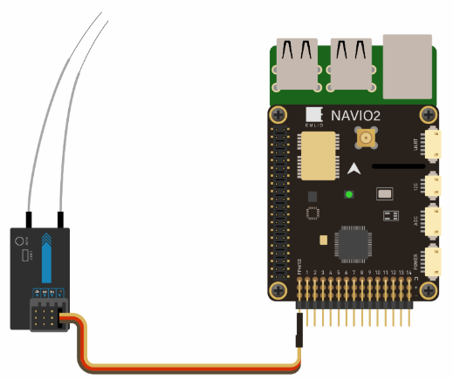
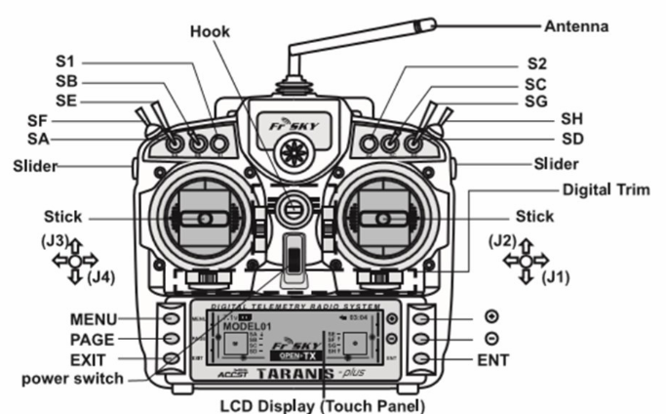
RC input
PPM 과 SBUS 형식의 RC 입력 신호만을 지원한다.
PPM 타입 RC Controller
Frsky Taranis
https://www.frsky-rc.com/product/taranis-x9d-plus-2/

Slide 18
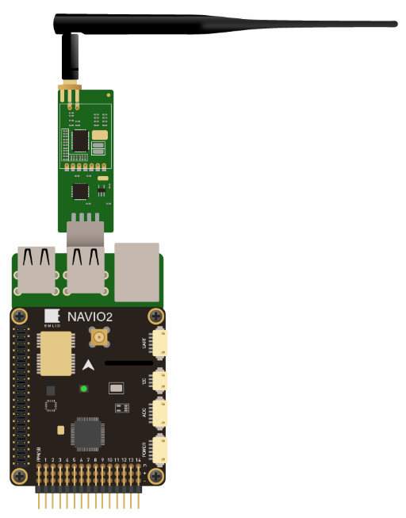
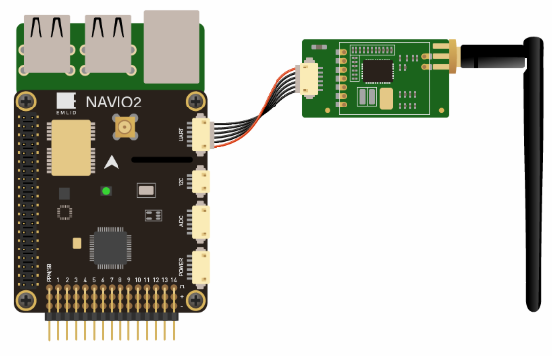
Telemetry Modem
UART radio
For UART port use /dev/ttyAMA0 serial.
USB radio
Use /dev/ttyUSB0 virtual serial port for USB.

Slide 19
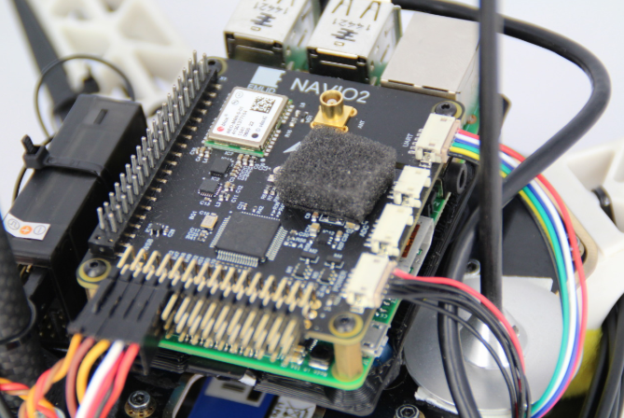
Barometer UV protection
MS5611 barometer (steel cap IC) is sensitive to UV light and might report sudden jumps in altitude under sunlight.
It is very important to cover it with a piece of open cell foam (something like microphone fabric) or put autopilot in a protective case to protect it both from sunlight and airstreams.

Slide 20
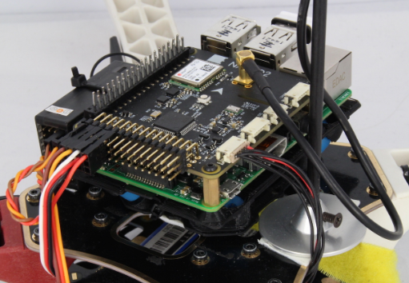
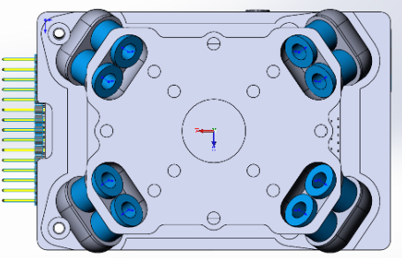
Anti-vibration mount 1
We have designed an anti-vibration for Navio that can be easily 3D printed.
It significantly simplifies mounting and eliminates vibrations.

Slide 21
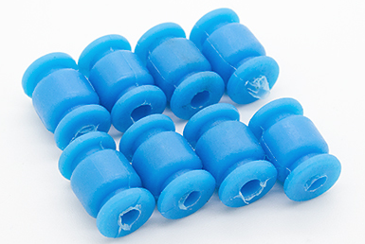
Anti-vibration mount 2
STL Files
Top
https://github.com/emlid/hardware/blob/master/VibroNavio2top_rev_A.STL
Bottom
https://github.com/emlid/hardware/blob/master/VibroNavio2bot_rev_A.STL
You will also need 8 blue vibration damping balls from Hobbyking

Slide 22
NAVIO S/W 설치
조립

Slide 23
라즈비안 설치
기설정된 라즈비안 이미지 다운로드
http://files.emlid.com/images/emlid-raspbian-20190227.img.xz

Slide 24
라즈비안 환경 설정
Wi-Fi 설정
sudo vi /etc/wpa_supplicant/wpa_supplicant.conf
network={
ssid="yourssid"
psk="yourpasskey"
}
Expading rootfs
sudo raspi-config --expand-rootfs

Slide 25
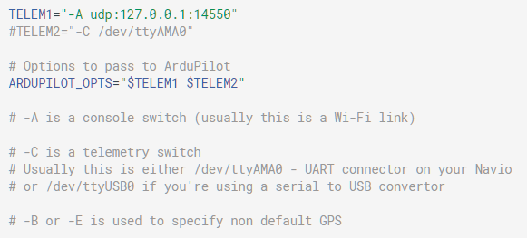
Specifying launching options
Open the file:
sudo nano /etc/default/arducopter
sudo systemctl daemon-reload
Here you can specify IP of your ground station.

Slide 26
Launching a custom ArduPilot binary
Navio is supported in ArduPilot upstream and if you'd like to build the binary yourself please proceed to the Building from sources.
https://docs.emlid.com/navio2/common/ardupilot/building-from-sources/
Download arducopter binary
wget http://firmware.eu.ardupilot.org/Copter/stable/navio2/arducopter
chmod +x arducopter

Slide 27
Launching a custom ArduPilot binary 2
서비스 파일 /etc/systemd/system/ardupilot.service 을 편집한다.
[Unit]
Description=ArduPilot for Linux
After=systemd-modules-load.service
Documentation=https://docs.emlid.com/navio2/navio-ardupilot/installation-and-running/#autostarting-ardupilot-on-boot
Conflicts=arduplane.service arducopter.service ardurover.service
[Service]
EnvironmentFile=/etc/default/ardupilot
# Uncomment and modify this line if you want to launch your own binary
ExecStart=/bin/sh -c "/home/pi/arducopter ${ARDUPILOT_OPTS}"
##### CAUTION ######
# There should be only one uncommented ExecStart in this file
Restart=on-failure
[Install]
WantedBy=multi-user.target

Slide 28
Launching a custom ArduPilot binary 3
ArduPilot 재시작
sudo systemctl daemon-reload
sudo systemctl start ardupilot
sudo systemctl enable ardupilot

Slide 29
Building from sources
Download the ArduPilot code and update submodules:
git clone https://github.com/ArduPilot/ardupilot.git
cd ardupilot
git submodule update --init –recursive
Checkout to a specific tag in order not to fly off master
git checkout ArduCopter-stable
Aliasing
alias waf="$PWD/modules/waf/waf-light"
Waf config
waf configure --board=navio2
pyton future 패키지 설처
pip install future
Build arducopter
waf copter
Transfer the binary to a Raspberry Pi
rsync -avz build/navio2/bin/arducopter-quad pi@192.168.1.101:/home/pi/

Slide 30
GT-R530 NX

Slide 31
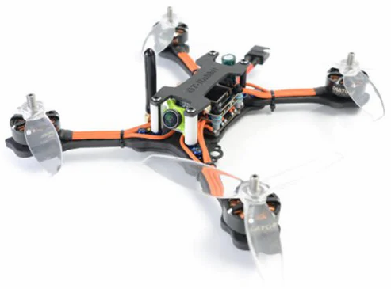
GT-R530 NX
가격 : $ 200
F405 Flight Controller
Item Name: F405 Betaflight FC AIO OSD BEC
Input Power: 12.6 - 25V ( 3 - 6S )
BEC: 5V / 1.5A
MCU: STM32F405
Gyro: MPU6000, 8K Six-Axis
Max Lipo Cell: 3 – 5
FPV Transmitter
FPV Camera
Item Name: Runcam Micro Swift FPV
Camera
Image Sensor: 1/3 inch SONY Super HAD II Signal System: PAL / NTSC
S / N Ratio: more than 60dB ( AGC OFF )
Electronic Shutter Speed: PAL: 1 / 50 ~ 100,000; NTSC: 1 / 60 ~ 100,000
AutoGain Control ( AGC ): YES
Power: DC 5 to 36V

Slide 32
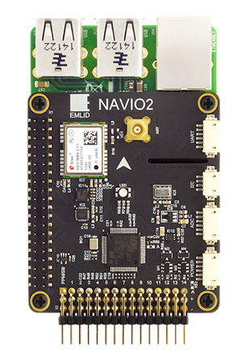
NAVIO2 + GT-R530 드론 조립
구분 | 제품 | 모델/스펙 | 가격 | 수량
 | 모터/센서/본체 | GT - R530 NX | 23만원 | 1
 | 컴퓨터 | RASPBERRY PI B+ | 5 만원 | 1
 | 콘트롤러 | NAVIO2 | 20 만원 | 1
계 |  |  | 48 만원

Slide 33
NAVIO2 기반 드론 조립
콘트롤러
NAVIO2 (10만원)
https://emlid.com/navio/
본체
GT-R530 NX( $ 243 )
https://www.gearbest.com/brush-fpv-racer/pp_009542172048.html?wid=1433363
SHRC H1G ($ 94)
https://www.gearbest.com/rc-quadcopters/pp_009187953341.html?wid=1433363
JDRC JD ($ 80)
https://www.gearbest.com/rc-quadcopters/pp_009531904281.html?wid=1433363
GEPRC Mark2 ($ 264)
https://www.gearbest.com/brush-fpv-racer/pp_009166157856.html?wid=1433363
Aurora RC Mini Fight ($ 137)
https://www.gearbest.com/brushless-fpv-racer/pp_1156927.html?wid=1433363

Slide 34
NAVIO2 드론 조립 예
https://community.emlid.com/t/first-build-quadcopter-autonomous-drone-rpi-3-b-navio2/12597

Slide 35
끝.

